Slide 1
"Introduction in Social Network Analysis”
Dr. Aprna Tripathi

Slide 2
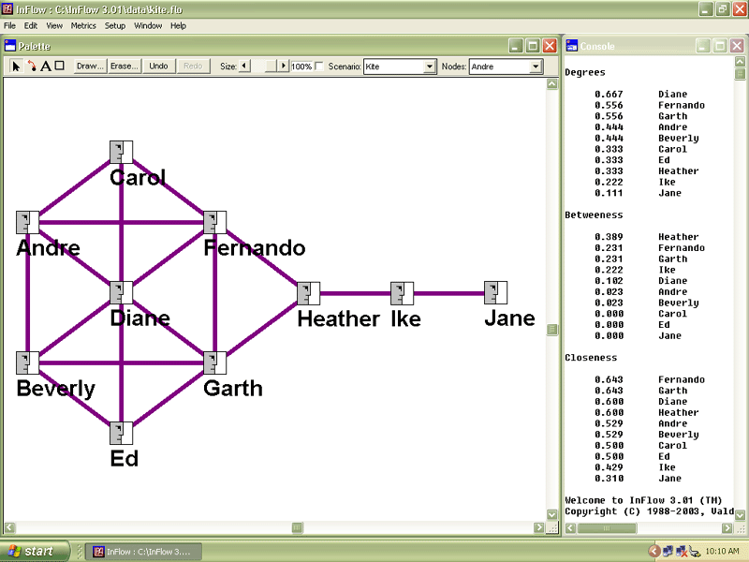
http://www.orgnet.com/sna.html

Slide 3
What is a network?
Definition:
„(...) a specific set of linkages among a defined set of persons with the additional property that the characteristics of these linkages as a whole may be used to interpret the social behavior of the persons involved.“ (Mitchell 1969:2)
Primary literature:
Wasserman, Stanley / Faust, Katherine (2008): Social Network Analysis. Methods and Applications, Cambridge, University Press

Slide 4
What is Social Network Analysis?
“(…) is based on an assumption of the importance of relationships among interacting units“ (Wasserman/Faust 2008:4)
“(…) encompasses theories, models, and applications that are expressed in terms of relational concepts or processes” (Wasserman/Faust 2008:4)
“(…) the unit of analysis in network analysis is not the individual, but an entity consisting of a collection of individuals and the linkages among them” (Wasserman/Faust 2008:5)
Network methods focus on:
Dyads (two actors and their ties)
Triads (three actors and their ties)
Larger systems (subgroups of individuals, or entire networks)

Slide 5
Principles of Social Network Analysis
Actors and their actions are viewed as interdependent rather than independent, autonomous units
Relational ties (linkages) between actors are channels for transfer or “flow” of resources (either material or nonmaterial)
Network models focusing on individuals view the network structure environment as providing opportunities for or constraints on individual action
Network models conceptualize structure (social, economic, political, and so forth) as lasting patterns of relations among actors
(Wasserman/Faust 2008:4)

Slide 6
The Social Network Approach
The world is composed of networks
- not densely-knit, tightly-bounded groups
Networks provide flexible means of social organization and of thinking about social organization
Networks have emergent properties of structure and composition
Networks are a major source of social capital
Networks are self-shaping and reflexive
Networks scale up to networks of networks

Slide 7
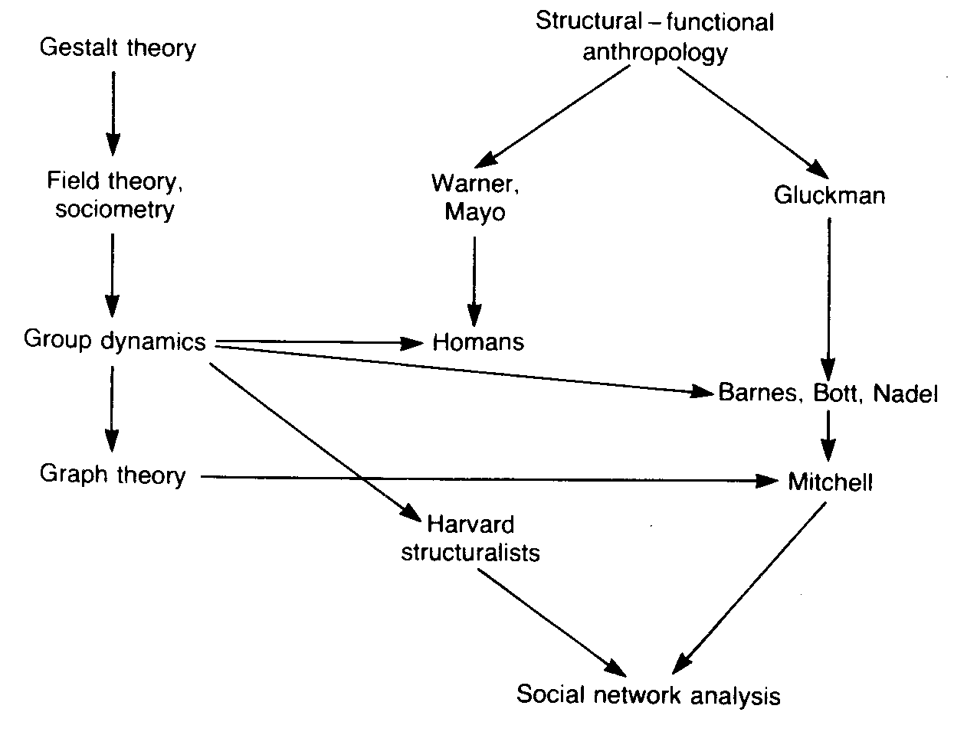
Overview about the development of
Social Network Analsis
1930
1950/60
1970
(Scott 1991, 7)
Notes:
Simmel:
Soziologie sollte sich – statt den Inhalten – den Formen der Vergesellschaftung durch eben diese Wechselwirkungen widmen(Beziehungen zwischen Individuen rückten ins Zentrum)
1933 Der Psychologen Moreno (der späteren Begründer des “Psychodramas”) stellt die Soziometrie (visuelle Darstellung von Beziehungen) erstmals als wiss. Methode auf einem Medizinischen Kongreß vor.

Slide 8
Which differences exist between a social network analysis and a non-network explanation?
in non-network explanations the main focus is on: attributes of autonomous individual units, the associations among these attributes, and the usefulness of one or more attributes for predicting the level of another attribute
social network analysis:
refers to the set of actors and the ties among them
views on characteristics of the social units arising out of structural or relational processes or focuses on properties of the relational system themselves
inclusion of concepts and information on relationships among units in a study
(Wasserman/Faust 2008: 6-9)

Slide 9
Which differences exist between a social network analysis and a non-network explanation?
the task is to understand properties of the social (economic or political) structural environment, and
how these structural properties influence observed characteristics and associations among characteristics
relational ties among actors are primary and attributes of actors are secondary
each individual has ties to other individuals, each of whom in turn is tied to a few, some, or many others, and so on
(Wasserman/Faust 2008: 6-9)

Slide 10
What is a Social Network?
A set of nodes (e.g., people, organisations, nation-states, etc.)
A set of connections between nodes (e.g., friends, acquaintances, relatives)
“consists of a finite set or sets of actors and the relation or relations defined on them. The presence of relational information is a critical and defining feature of a social network.” (Wasserman/Faust 2008:20)
“A social network arises when all actors can, theoretically, have ties to all relevant actors” (Wasserman/Faust 2008:42)
Shows how information is or can be communicated
Shows how important are individual ‘nodes’ to the ability of the network to communicate
Shows if there are key players in the network
Shows if there are isolated parts of the network

Slide 11
Fundamental Concepts in Network Analysis
actor
relational tie
dyad
triad
subgroup
group
relation
social network

Slide 12
Actor
“discrete individual, corporate, or collective social units” (Wasserman/Faust 2008:17)
Examples: people in a group, departments within in a corporation, public service agency in a city, nation-states in the world system
Does not imply that they have volition or the ability to “act”

Slide 13
Relational tie
Actors are linked to another by social ties
A tie “establishes a linkage between a pair of actors”
Example of ties in SNA (Wasserman/Faust 2008:17):
Evaluation of one person by another (expressed friendship, linking, or respect)
Transfers of material resources (business transactions, lending or borrowing things)
Association or affiliation (jointly attending a social event, or belonging to the same social club)
Behavioral interaction (talking together, sending messages)
Movement between places or statuses (migration, social or physical mobility)
Physical connection (a road, river, or bridge connecting two points)
Formal relations (authority)
Biological relationships (kinship or descent)

Slide 14
Dyad
a tie between two actors
“consists of a pair of actors and the (possible) tie(s) between them” (Wasserman/Faust 2008:18)
Shows “properties of pairwise relationships, such as whether ties are reciprocated or not, or whether specific types of multiple relationships tend to occur together” (Wasserman/Faust 2008:18)

Slide 15
Triad
“Triples of actors and associated ties” (Wasserman/Faust 2008:19)
“a subset of three actors and the (possible) tie(s) among them” (Wasserman/Faust 2008:19)
Triadic analyses focus on the fact whether the triad is
Transitive : if actor i “likes” actor j, and actor j in turn “likes” actor k, then actor i will also “like” actor k
Balanced: if actors i and j like each other, then i and j should be similar in their evaluation of a third actor, k, and i and j dislike each other, then they should differ in their evaluation of third actor, k

Slide 16
Subgroup
Subgroup of actors is defined “as any subset of actors, and all ties among them” (Wasserman/Faust 2008:19)

Slide 17
Group
“is the collection of all actors on which ties are to be measured” (Wasserman/Faust 2008:19)
Actors in a group “belong together in a more or less bounded set (…) consists of a finite set of individuals on which network measurements are made” (Wasserman/Faust 2008:19)
“The restriction to a finite set or sets of actors is an analytic requirement. Though one could conceive of ties extending among actors in a nearly infinite group of acts, one would have great difficulty analyzing data such a network. Modeling finite groups presents some of the more problematic issues in network analysis, including the specification of network boundaries, sampling, and the definition of group. Network sampling and boundary specification are important issues.” (Wasserman/Faust 2008:19f.)
“however, in research applications we are usually forced to look at finite collections of actors and ties between them.” (Wasserman/Faust 2008:20)

Slide 18
Relation
“the collection of ties of a specific kind among members of a group” (Wasserman/Faust 2008:20)
Example: the set of friendship among pairs of children in a classroom
For group of actors, several different relations might be measured
“refers to the collection of ties of a given kind measured on pairs of actors from a specified actor set” (Wasserman/Faust 2008:20)
Ties themselves only exist between specific pairs of actors

Slide 19
Work data sets
What are network data?
Boundary specification and sampling
Types of networks

Slide 20
What are network data?
variables
modes
affiliation variables

Slide 21
Variables
(Wasserman/Faust 2008:29)
structural variables:
are measured on pairs of actors and are the cornerstone of social network data sets
measure ties of a specific kind between pairs of actors
example: business transaction between corporations, friendship between people, trade between nations
composition variables:
measurements of actor attributes (actor attribute variables)
are of the standard social and behavioral science variety
defined at the level of individual actors
example: gender, race, ethnicity for people

Slide 22
Modes
“the number of sets of entities on which structural variables are measured” (Wasserman/Faust 2008:35)
One-mode network: all actors come from one set
two-mode network: there are two set of actors: e.g. set consisting of corporations and another of non-profit organizations, contains measurements on which actors from one set have ties to actors from the other set
higher-mode network: more set of entities: actors from different sets

Slide 23
Affiliation Variables
each affiliation variable is defined on a specific subset of actors
a special type of two-mode network, but they only have one set of actors
the second mode is a set of events: such as clubs or voluntary organizations to which the actor belong
“events are defined not on pairs of actors, but on subsets of actors (…) often events are informal social occasions, such as parties or other gatherings, and observations or attendance or interactions among people provide the affiliation of the actors ”
“subsets can be of any size”

Slide 24
Boundary specification and sampling I
What is your Population? (Wasserman/Faust 2008:31)
Who are the relevant actors?
Example: faculty in an academic department or corporations headquartered in a major metropolitan area: relatively easy to deal with
But what to do in other cases if the boundary of the set of actors may be difficult if not impossible to determine
“The boundary of a set of actors allows a researcher to describe and identify the population under study”
Actor set boundaries are often based on the relative frequency of interaction, or intensity of ties among members as contrasted with non-members

Slide 25
Boundary specification and sampling II
Two different approaches to boundary specification in social network studies (cf. Laumann, Marsden, Prensk 1989)
Realist approach: focuses on actor set boundaries and membership as perceived by the actors themselves (e.g. a street gang, members acknowledge as belonging to the gang)
Nominalist approach: based on the theoretical concerns of the researcher (e.g. flow of computer messages among researchers in a scientific community; the list of actors might be the collection of people who published papers on the topic in the previous five years)
In several applications, when the boundary is unknown, special sampling techniques such as snowball sampling and random nets
(Wasserman/Faust 2008:32)

Slide 26
Boundary specification and sampling III: Sampling
sometimes it is not possible to take measurements on all actors in the relevant actor set (Wasserman/Faust 2008:33)
is seen as “representative of the larger, theoretically interesting population (which must have a well-defined boundary and hence, a known size), and uses the sampled actors and data to make inferences about the population)
example:
snowball network sample (cf. Goodman 1961): “begins when the actors in a set of sample respondents report on the actors to whom they have ties of a specific kind” (Wasserman/Faust 2008:34)
all of the nominated actors constitute the “first order “ zone of the network
then all actors in this zone will be sampled and all the additional actors (those nominated by the actors in the “first order” zone who are not among the original respondents or those in this zone) are gathered
these additional actors constitute the “second order” zone
it is a chain method what means that several “order zones” can be defined

Slide 27
"Introduction in Social Network Analysis. Theoretical Approaches and Empirical Analysis with computer-assisted programmes."
II. meeting:
Types of networks for SNA
From organic solidarity (Durkheim) to information society and network society (Castells)
Social capital

Slide 28
Social Network Analysis:
Focus on interactions between individuals/ groups
Node: Any entity in
a network
(person, system,
group, organization)
Tie: Relationship/ interaction
between two nodes.

Slide 29
Types of networks
Network can be categorized by the nature of the sets of actors and the properties of the ties among them
“The number of modes in a network refers to the number of distinct kinds of social entities in the network” (Wasserman/Faust 2008:35)
One-mode networks: a single set of actors
Two-mode networks: focus on two sets of actors, or one set of actors and one set of events

Slide 30
One-mode networks: a single set of actors (Wasserman/Faust 2008:36f.)
actor
relations
actor attributes

Slide 31
Actors in one-mode networks
can be a variety of types
People
Subgroups (consist of people
Organizations
Collectives / Aggregates: Communities (consists of subgroups of people), nation-states (larger entities, containing many organizations and subgroups)

Slide 32
Relations in one-mode networks
several kind of relations can be studied: (Wasserman/Faust 2008:37)
→ individual evaluations: friendship, linking, respect → “measurements of positive or negative affect of one person for another”
transactions or transfer of material resources: lending or borrowing; buying or selling, contacts made by one actor of another in order to secure valuable resources, transfer of goods, exchange of gifts, social support ties
transfer of non-material resources: communications, sending/receiving information → frequently communications between actors, where ties represent messages transmitted or information received

Slide 33
Relations in one-mode networks
interactions: “involve the physical interaction of actors or their presence in the same place at the same time” (Wasserman/Faust 2008:38), e.g. sitting next to each other, attending the same party, visiting a person’s home
movement: physical (migration from place-to-place), social (movement between occupations or statuses)
formal roles: e.g. dictated by power and authority in a management setting
kinship: marriage, descent

Slide 34
Actor Attributes
People can be queried about different features, like
age
gender
race
socioeconomic status
place of residence
grade in school, etc.

Slide 35
Two Sets of Actors
Relations measure ties between the actors in one set and actors in a second set
Such networks are dyadic two-mode networks, “since these relations are functions of dyads in which the first actor and the second actor in the dyad are from different sets” (Wasserman/Faust 2008:39)

Slide 36
Degree
Number of links that a node has
It corresponds to the local centrality in social network analysis
It measures how important is a node with respect to its nearest neighbors
Directed Graph
Indegree & Outdegree

Slide 37
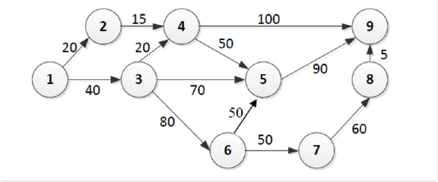
What is the size of the graph
What is the In-Degree & Out-Degree of Node 5 ?
What is the In-Degree & Out-Degree of Node 4 with weight ?

Slide 38
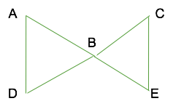
Path Length
AB, AE, and BE have path length of 1 (1 line connects each pair of points)
A and C are connected through B and have a path length of 2 (2 lines)
there are no isolated points
every point can reach every other point within 2 steps

Slide 39

Path
AD has a path length of 1
the walk ABCAD is not a path (passes through A twice!)
ABCD has a path length of 3
A and D are connected by 3 paths
AD – length 1
ACD – length 2
ABCD – length 3
  the distance between A and D is equal to the shortest path

Slide 40
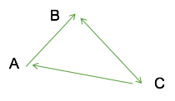
Path
directed graphs are similar except for the possible asymmetry of the relationship
degree has two separate components:
indegree: total numbers of alters related to ego; A=1, B=2, C=1
outdegree: total numbers of points ego relates to; A=1 , B=1 , C=2
paths: CAB is a path, CBA is not a path!

Slide 41
What is the path length from node 1 to node 9
Shortest path

Slide 42
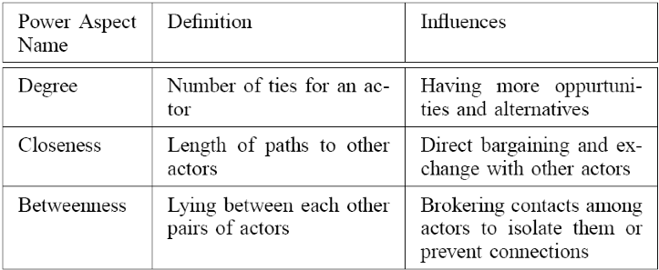
Centrality & Power

Slide 43
Graph Density
describes the general level of contectedness in a graph
graph is complete if all points are adjacent to each other
the more points that are connected, the greater the density
there are two components for density
inclusiveness: number of points that are included in the graph because they are connected
total degree: sum of degree of all the points

Slide 44
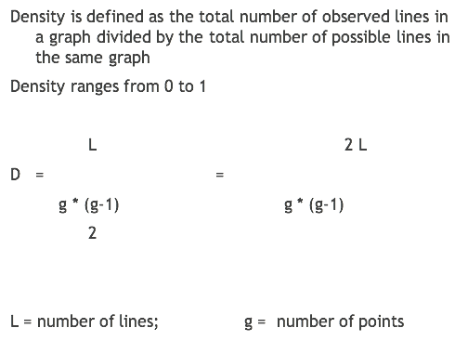
Graph Density

Slide 45
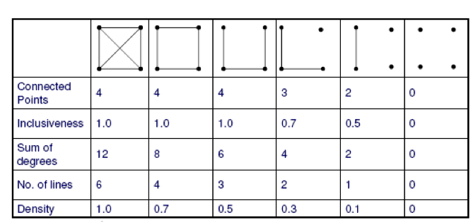
Graph Density Example

Slide 46
The density of this graph?

Slide 47
Density
actual number of connections in a network
expressed as a proportion of the total possible number of connections
figure between 0 and 1

Slide 48
A simple relational matrix in which presence/absence of a relation is indicated by a 1 or 0 respectively: who drinks with whom?
 | Tom | Dick | Sally | Fred | Alice
Tom | 0 | 0 | 1 | 1 | 0
Dick | 0 | 0 | 1 | 1 | 0
Sally | 1 | 1 | 0 | 0 | 1
Fred | 1 | 1 | 0 | 0 | 0
Alice | 0 | 0 | 1 | 0 | 0

Slide 49
Note that in this case there is unnecessary repetition of information: if Tom drinks with Sally then Sally drinks with Tom
 | Tom |  | Sally
Tom |  |  | 1
Sally | 1
We need to be mindful of this in any calculations we may make. We have one relationship here, not two.

Slide 50
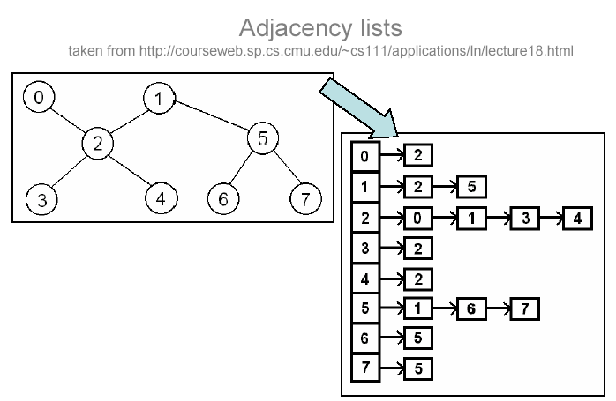

Slide 51
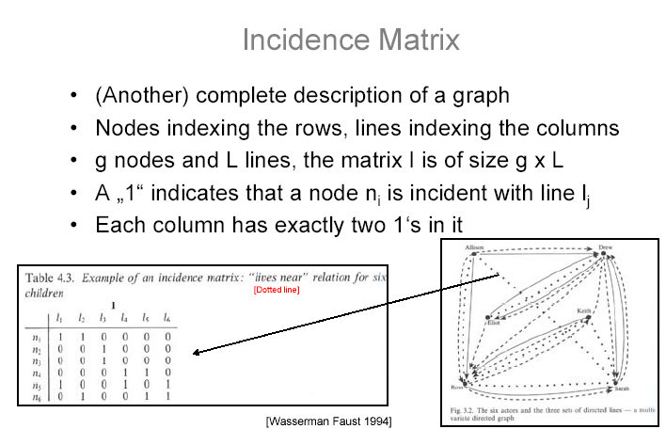

Slide 52
Centrality
Important or prominent actors are those that are linked or involved with other actors extensively
A person with extensive contacts (links) or communications with many other people
central actor is one involved in many ties.

Slide 53
Betweenness Centrality
If two non-adjacent actors j and k want to interact and actor i is on the path between j and k, then i may have some control over the interactions between j and k
Betweenness measures this control of i over other pairs of actors
Thus, if i is on the paths of many such interactions, then i is an important actor.

Slide 54
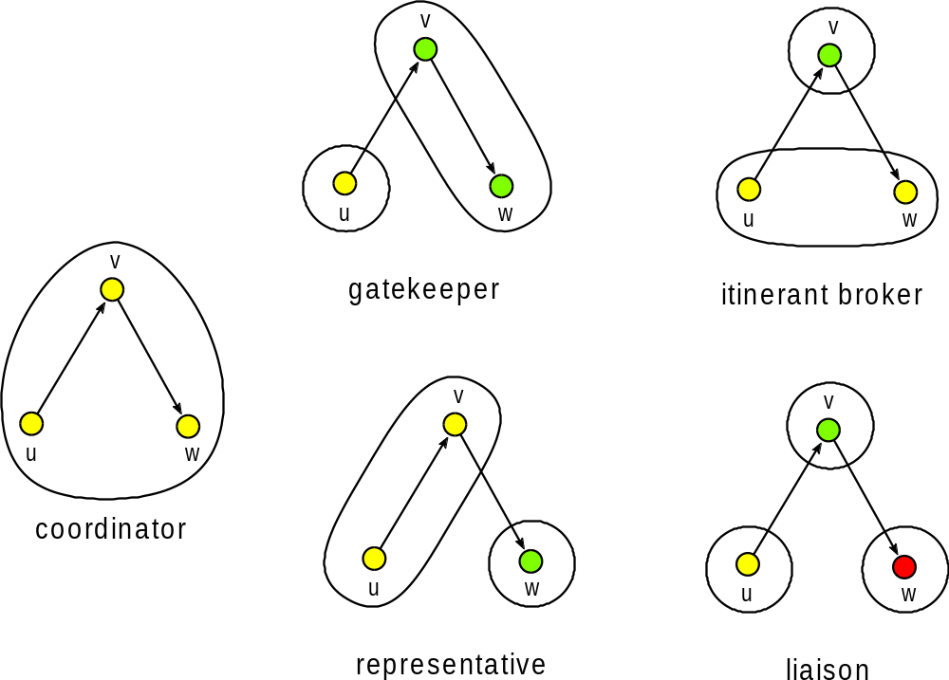
Brokerage roles
Sunbelt XXIV, Portorož, 2004

Slide 55
Prestige
a more refined measure of prominence of an actor than centrality
a prestigious actor is one who is object of extensive ties as a recipient
Difference between centrality and prestige:
centrality focuses on out-links
prestige focuses on in-links

